Slide 1

DiLBERT: Cheap Embeddings for Disease Related NLP
Alvi Anowar
23366031
CSE - 713

Slide 2
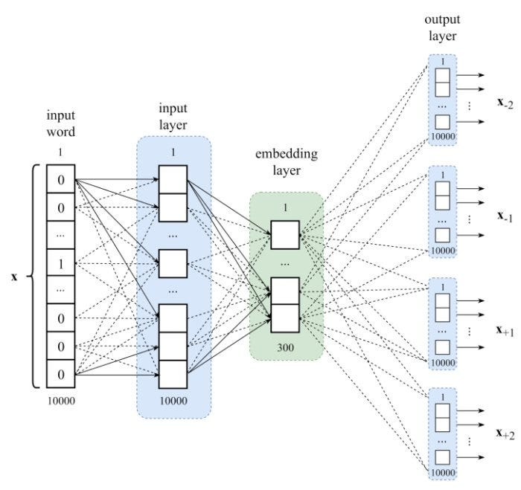
Introduction
Time consuming and demanding manual coding.
NLP models are effective at the sentence level.
Specialized models are needed for diagnostic expressions in the biomedical domain.

Slide 3

RELATED WORK
Wang et al:
A RNN approach for classifying diseases of ICD-10-CM based on large free-text medical notes with F1 score of 0.62.
Della Mea et al:
Used biomedical BERT models to identify the underlying cause of death from death certificates.
Zhang et al.:
Trained a BERT model on EHR notes, adapting the BERT architecture for ICD coding with multi-label attention.

Slide 4

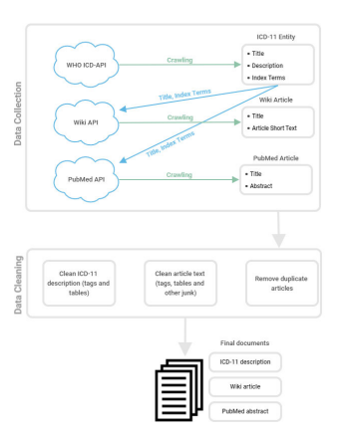

Methodology
Introduction of a specialized BERT model for diagnosing health conditions.
Creation of a pre-training corpus using ICD-11 entities to leverage transfer learning capabilities of NLP models.
Disease-related language model created through pre-training on ICD-11 entities, supplemented with PubMed and Wikipedia documents.
Fine-tuning performed for three downstream tasks using two different datasets, demonstrating comparable or higher accuracy despite a smaller training corpus.

Slide 5
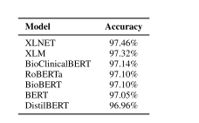
Conclusion
Performance
Model achieved 97.53% accuracy on death certificate coding.
81.32% accuracy on clinical document coding
Despite a smaller corpus, the model's performance equals or surpasses existing state-of-the-art models.
Future Research:
Future research should explore multi-stage fine-tuning processes and test the model on tasks related to different terminologies as data sets become available.

Slide 6


Thank You

